Slide 1

ENGINEERING CHEMISTRY
Asha A
Department of Science and Humanities

Slide 2

ENGINEERING CHEMISTRY
Module I- Molecular Spectroscopy
Class Content:
Vibrational spectroscopy-Anharmonic Oscillator
Expression for vibrational energy levels for an Anharmonic oscillator
Vibrational spectrum of an Anharmonic Oscillator

Slide 3
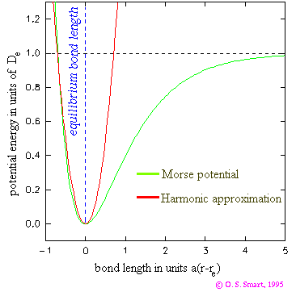
ENGINEERING CHEMISTRY
Module I- Molecular Spectroscopy
In actual diatomics, the potential is anharmonic because the bond when stretched beyond a point breaks and the molecule dissociates
A good description of an anharmonic oscillator is given by the Morse function
P.E. = D_{eq} [1 – exp {a(r_{o}-r }]²
D_{eq} is the depth of the PE curve
r₀ is the bond length
Vibrational spectroscopy-Anharmonic oscillator model
Source:https://physics.stackexchange.com/questions/54814/why-is-there-a-global-minimum-for-the-morse-potential/55077

Slide 4
ENGINEERING CHEMISTRY
Module I- Molecular Spectroscopy
Energy levels of an anharmonic oscillator:
Solving the Schrodinger equation for anharmonic oscillator the
vibrational energy levels are given by the expression
x_{e}, is called the anharmonicity constant whose value for bond
stretching vibrations is always small and positive
is the oscillation frequency expressed in wavenumbers
v is the vibrational quantum number which can take up values 0,1,2,3….
Substituting values for v we get the energy levels for an anharmonic
oscillator

Slide 5
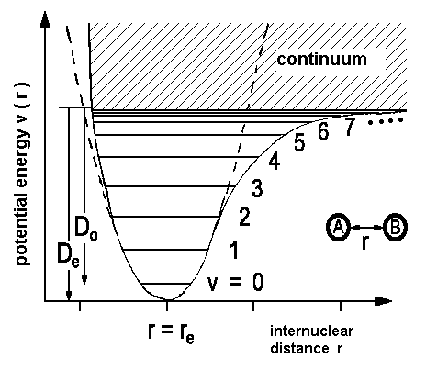
ENGINEERING CHEMISTRY
Module I- Molecular Spectroscopy
Energy level diagram for a diatomic molecule showing anharmonicity
Source:http://www.pci.tu-bs.de/aggericke/PC4e/Kap_III/Vibration.htm
The spacing between energy levels decreases as v , the vibrational quantum number, increases

Slide 6
ENGINEERING CHEMISTRY
Module I- Molecular Spectroscopy
Selection rules for vibrational transition of anharmonic oscillator :
Gross selection rule : When a molecule vibrates there should be
change in dipole moment
Δv = ± 1, ±2, ±3.........
Most of the transitions start from v=0 level because this state is
most populated
The transitions observed are :
v=0 → v=1 Fundamental absorption
v=0→ v= 2 First overtone
v=0 → v=3 Second overtone

Slide 7
ENGINEERING CHEMISTRY
Module I- Molecular Spectroscopy
Substituting for values of v, we get the energy gap
Transition | Energy gap
v=0 to v=1 |  | Fundamental absorption
v=0 to v=2 |  | First overtone
v=0 to v=3 |  | Second overtone

Slide 8
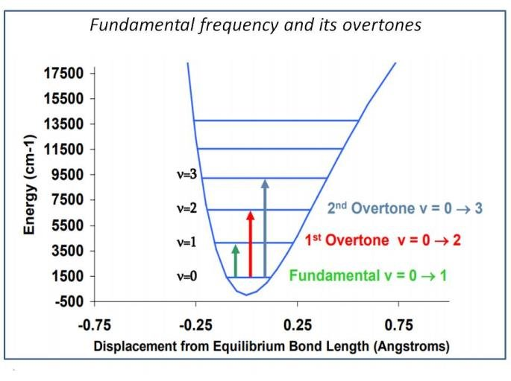
Vibrational transitions for diatomic molecule undergoing anharmonic oscillations
ENGINEERING CHEMISTRY
Module I- Molecular Spectroscopy
Source:https://www.researchgate.net/figure/Fundamental-frequency-and-overtones-see-lecture-N-Antaris_fig2_331976119
The spacing between the lines in the spectrum decreases as we go to higher values of v
cm⁻¹

Slide 9
ENGINEERING CHEMISTRY
Module I- Molecular Spectroscopy
At higher temperatures additional lines are visible in the spectrum as higher vibrational levels may also get populated and these lines originating from the higher vibrational levels are called hot bands
e.g., Energy absorbed for the transition from v=1 to v=2 is given by,
The expression shows that this line will appear to the left of the fundamental absorption in the spectrum

Slide 10
ENGINEERING CHEMISTRY
Module I- Molecular Spectroscopy
Class content:
Electronic spectroscopy
Born – Oppenheimer Approximation
Vibrational coarse structure-Progressions

Slide 11
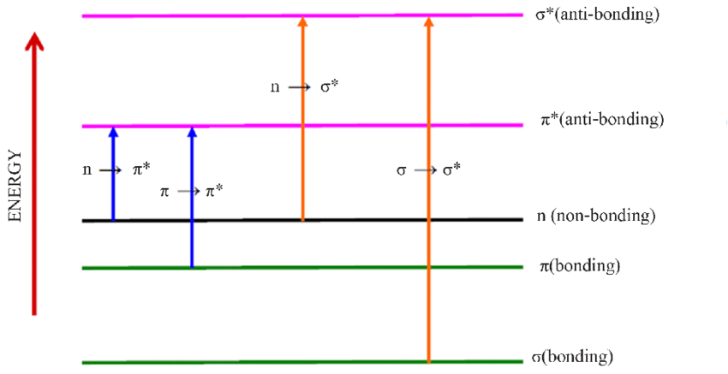
Electronic spectroscopy
ENGINEERING CHEMISTRY
Module I- Molecular Spectroscopy
Electronic transitions :
Highest Occupied Molecular Orbitals (HOMO) → Lowest Unoccupied Molecular Orbitals(LUMO)
Transitions in UV-Visible region
σ → σ* , π → π* , n → π*
If transitions in visible region colour can be seen
Electron redistribution causes change in electric field
All molecules can undergo electronic transitions
Source:https://www.researchgate.net/figure/Energy-level-diagrams-with-electronic-transitions_fig3_265908281

Slide 12


ENGINEERING CHEMISTRY
Module I- Molecular Spectroscopy
Born-Oppenheimer approximation
According to Born-Oppenheimer approximation, the total energy of a molecule is the sum of translational, rotational, vibrational and electronic energies, i.e.
E = E_{r} + E_{v} + E_{e}
which implies that the electronic, vibrational and rotational energies of a molecule are completely independent of each other.
The change in total energy of the molecule is given by
in Joules
in cm⁻¹
The approximate orders of magnitude are
$$Δε_{Total}=Δε_{Rot}+Δε_{Vib}+Δε_{Electronic}$$
$$Δε_{Rot}×106≃Δε_{Vib}×103≃Δε_{Electronic}$$

Slide 13
ENGINEERING CHEMISTRY
Module I- Molecular Spectroscopy
Electronic transitions involve electronic redistribution hence electrostatic forces experienced by the molecule which vibrates in response and this in turn affects rotation of the molecule
Electronic transitions are accompanied by vibrational and rotational changes. Hence vibrational changes will produce “coarse structure” and rotational changes will produce “fine structure” in the electronic spectra of molecules
Information about vibrational and rotational structure of homonuclear molecules like H₂, N₂ which are inactive in IR and Microwave region can be obtained from their electronic spectra

Slide 14
ENGINEERING CHEMISTRY
Module I- Molecular Spectroscopy
Vibrational Coarse structure
The ground state energy levels are denoted by Ɛ” and v”, while the excited state energy levels are denoted by Ɛ’ and v’
There are no selection rules for vibrational transitions during electronic transition
4
3
2
1
v’ =0
ε’
E
4
3
2
1
v” =0
ε”

Slide 15
ENGINEERING CHEMISTRY
Module I- Molecular Spectroscopy
Most of the transitions start from v”=0 as it is the most populated level
4
3
2
1
v’ =0
ε’
E
4
3
2
1
v” =0
ε”

Slide 16
ENGINEERING CHEMISTRY
Module I- Molecular Spectroscopy
The lines in the resulting spectrum are denoted by (v’,v”)
The resulting spectrum is called progression
The lines converge at higher energy levels showing anharmonicity in the excited electronic state
Spectrum showing Progression
0,0 1,0 2,0 3,0 4,0
cm⁻¹

Slide 17
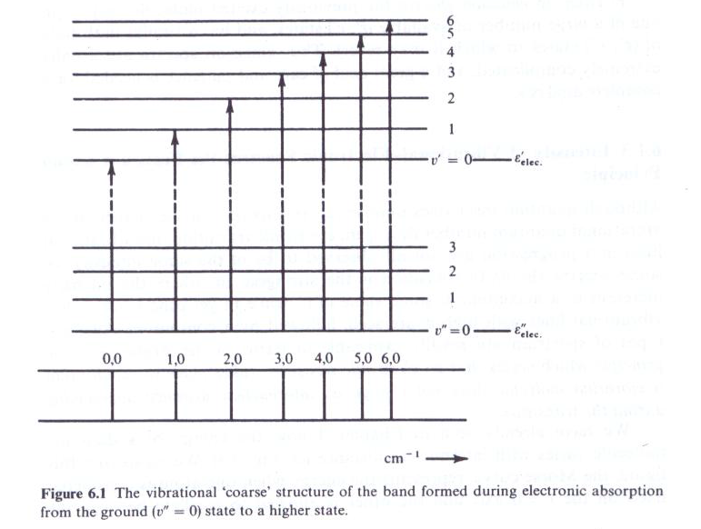
ENGINEERING CHEMISTRY
Module I- Molecular Spectroscopy
Vibrational ‘coarse structure’ during electronic transition
ε’
ε”
Source:Fundamentals of Molecular Spectroscopy: C. N. Banwell and Elaine M McCash, Fifth Edition, MCGRAW-HILL Education (India) Private Ltd.

Slide 18
THANK YOU
Asha A
Department of Science and Humanities

